Slide 1
BOTS(Book Our TurfS)
210943020016 Chaudhari Ganesh Dilip
210943020018 Deore Dhiraj Rajendra
210943020077 Rutuja Ramchandra Patil
210943020087 Saurabh Sharad Dashpute

Slide 2
Agenda
Project introduction
Project architecture
Technology platform used for project
User roles and responsibilities
Division of work within team
Details of my contribution
Known issues if any
Future extensions if any
Conclusion

Slide 3
Project Introduction
Purpose of the project
Yes, we have google maps to find out nearby facilities but PLAY HERE provide more features which are Specific to sports BOTS provides booking slots through web App so user can book them any time. BOTS is a platform where any team can post their game challenge to the other team with decided reward.
Need
We know the urban work-life balance isn’t always easy to juggle and our services takes the hassle away from finding places and co- players. It is difficult to find ground or related facility's for various team and individual games at new places And also sometimes we are in search of new teammates or new team. hassle away from finding places and co- players.

Slide 4
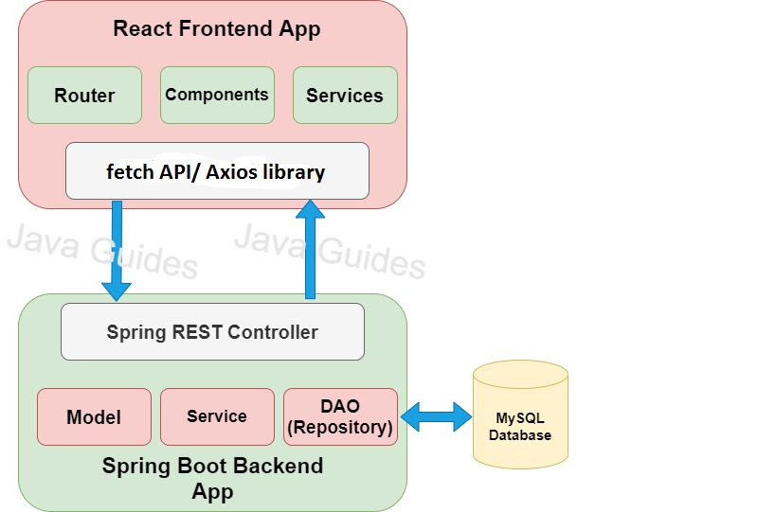
Project Architecture

Slide 5
Technology platform used for project
Technologies used :
Front end : HTML, CSS, Javascript, React JS
Middle tier : Springboot, Hibernate
Database : MySQL
Reason for selecting specific technologies
React JS :
-- The React basically allows developers to utilize individual parts of their application on both client-side and the server-side, which ultimately boosts the speed of the development process.
- Compared to other frontend frameworks, the React code is easier to maintain and is flexible due to its modular structure.
- The core of the framework offers a virtual DOM program and server-side rendering, which makes complex apps run extremely fast.

Slide 6
Spring boot
Its main purpose is RAD(Rapid Application Development).
It quickly releases the app in production environment and follows some development model ‘defaults opinionated approach ’. Spring boot comes with embedded tomcat server so there is no any context root and hence application is deployed as self deployable unit.
MySQL
MySQL is globally renowned for being the most secure and reliable database management system used in popular web applications like WordPress, Drupal, Joomla, Facebook and Twitter. The data security and support for transactional processing that accompany the recent version of MySQL, can greatly benefit any business especially if it is an eCommerce business that involves frequent money transfers.
MySQL offers unmatched scalability to facilitate the management of deeply embedded apps using a smaller footprint even in massive warehouses that stack terabytes of data. On-demand flexibility is the star feature of MySQL. This open source solution allows complete customization to eCommerce businesses with unique database server requirements.

Slide 7
User roles and responsibilities
User roles :
Admin
End user
Responsibilities for each user :
Admin : Handling of overall system, View bookings and transactions, adds turfs and grounds
End user : Book Turfs/ground and throw challenges
Use case for each role
Admin : add turfs/grounds, keeping track of overall operations
End user : registration for new account, booking and make a payment, post challenge

Slide 8
Details of my contribution
We have developed by contributing equally a web application in which we have worked on both frontend and backend.
First of all we completed documentation part by making BRS and SRS document, ER diagram, zero level DFD and page navigation diagram.
After completing documentation we moved on for creating database and then further worked on server side and simultaneously on front end for registration and login purpose.
Further we worked on services which includes ground booking and posting of challenges within the teams.

Slide 9
Known issues if any
The issue was when we were working on challenges feature. Even if end user accepted the challenge the challenge was still visible on announcement section.
We solved this issue by managing one extra field(isAccepted) for checking if the challenge is accepted or not.

Slide 10
Future extensions
Giving access of adding ground/turf to owner.
Sending a notification to owner whenever his ground is booked.
Teammate finder feature for end users.
Benefits of these implementations :
End user can post announcement in announcement section if he or she requires some particular number of players according to games rules and regulations.

Slide 11
Conclusion
In this way we have tried to solve problems which are faced by sportsman at new place. We believe that our sports player can focus more on their game with the help of this system.
Github link : https://github.com/Ruutu56/BOTS.git

Slide 12
Thank You

